Slide 1
Convolutional Neural Network
Done By: Toh Kien Yu (P2222291)
Background Research:
Image classification is an important part of digital image analysis and plays a crucial role in real world applications. For instance, visual search, object detection and more.
In this assignment, I will be doing image classification on vegetables using a deep learning network.

Slide 2
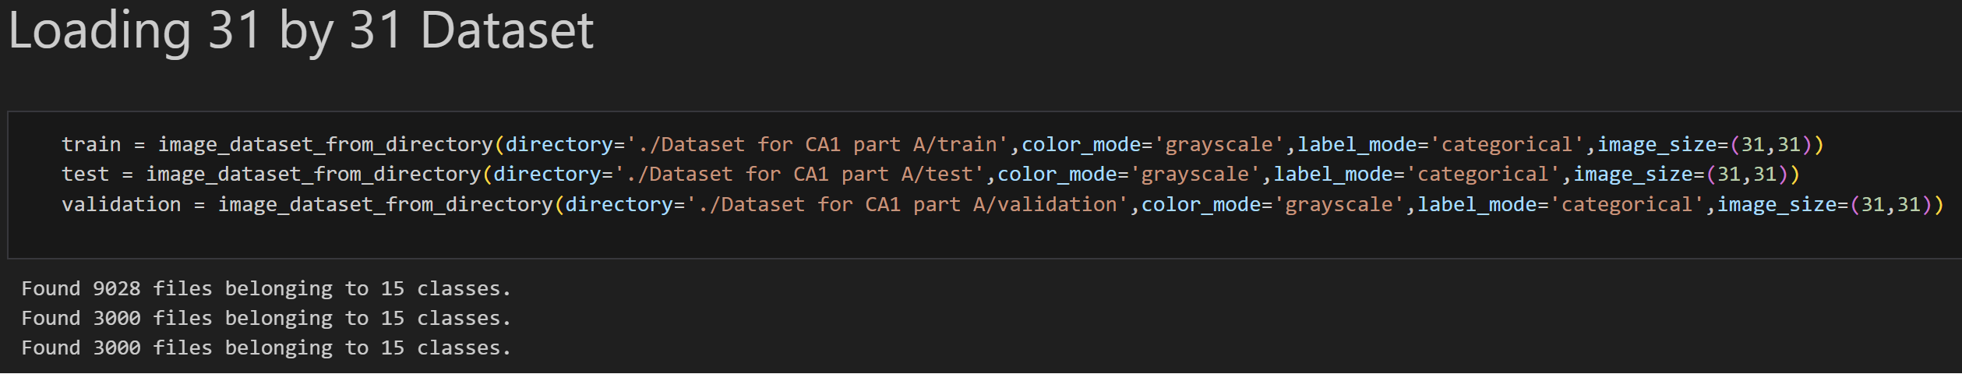
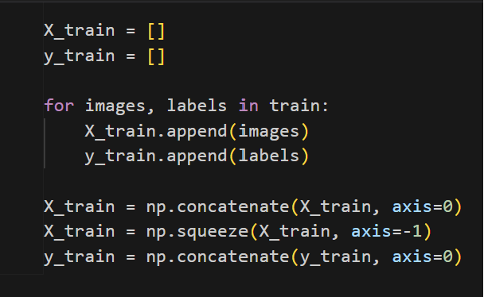
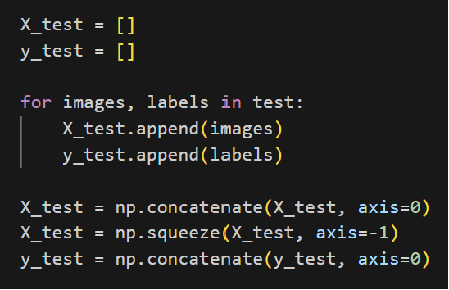
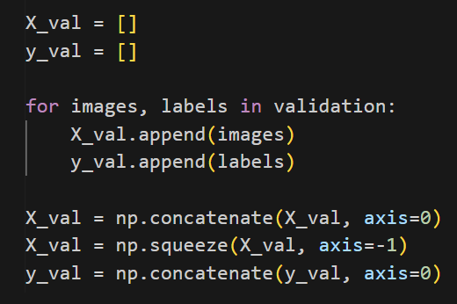
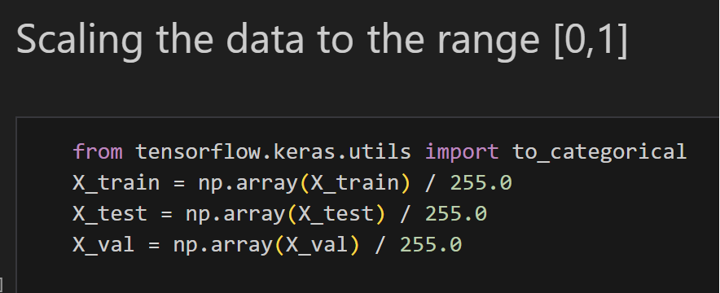
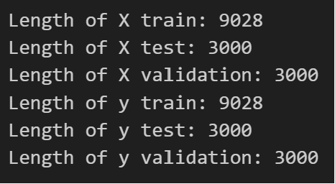
Data Preparation (31 by 31)
Loading of Dataset
Data Preparation
Data Standardization

Slide 3
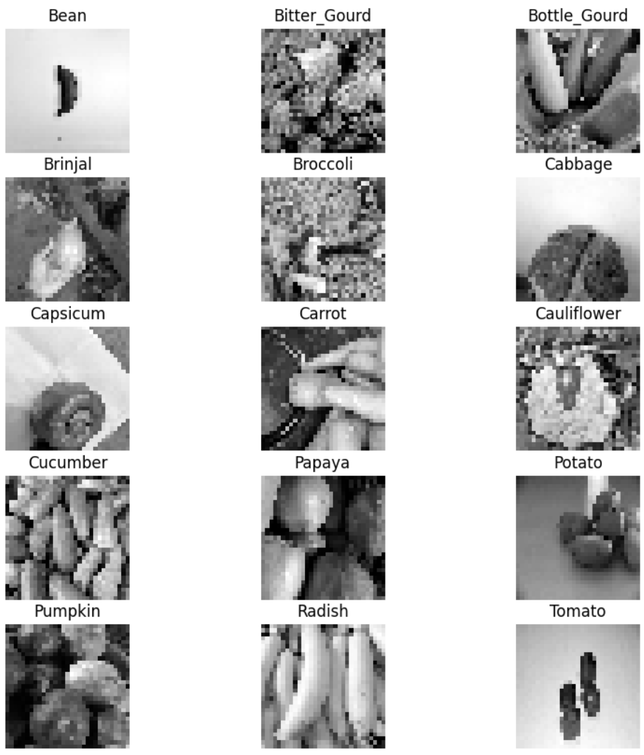
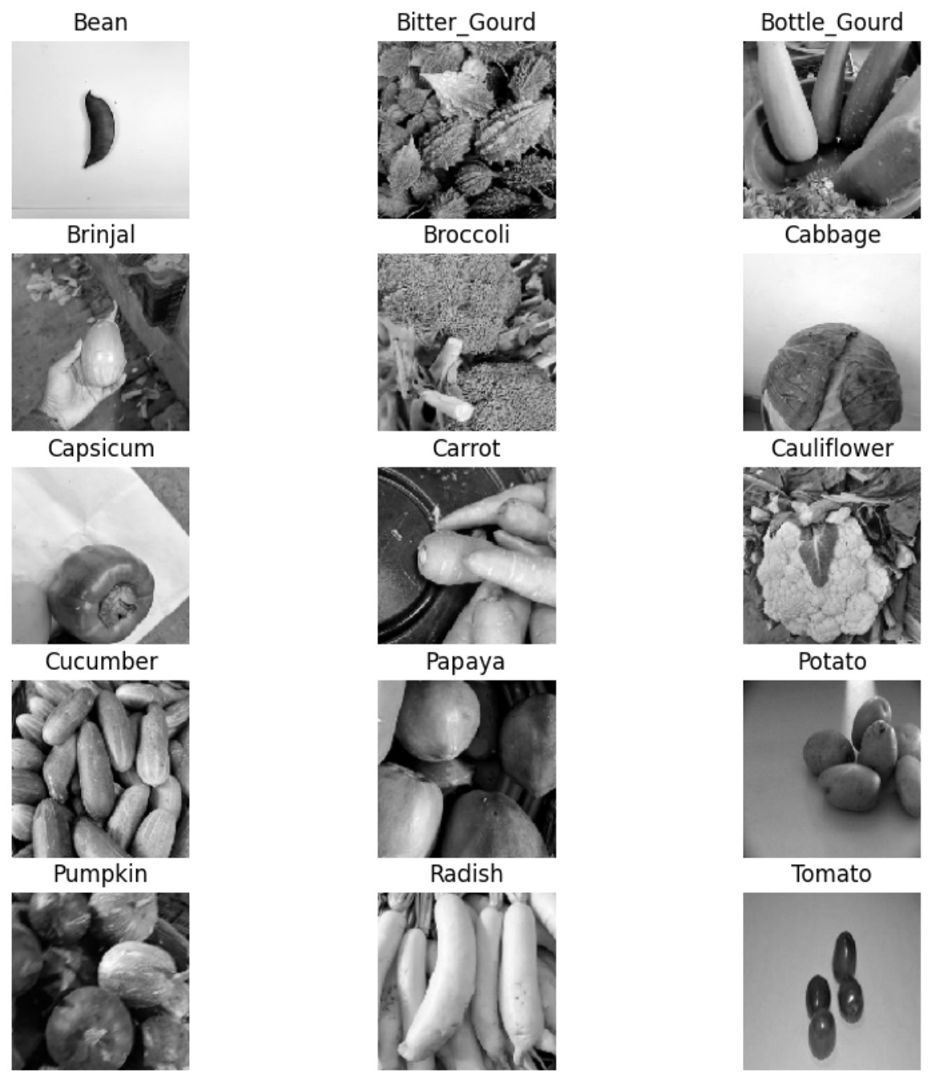
Exploratory Data Analysis
31 by 31 Training Images
128 by 128 Training Images

Slide 4
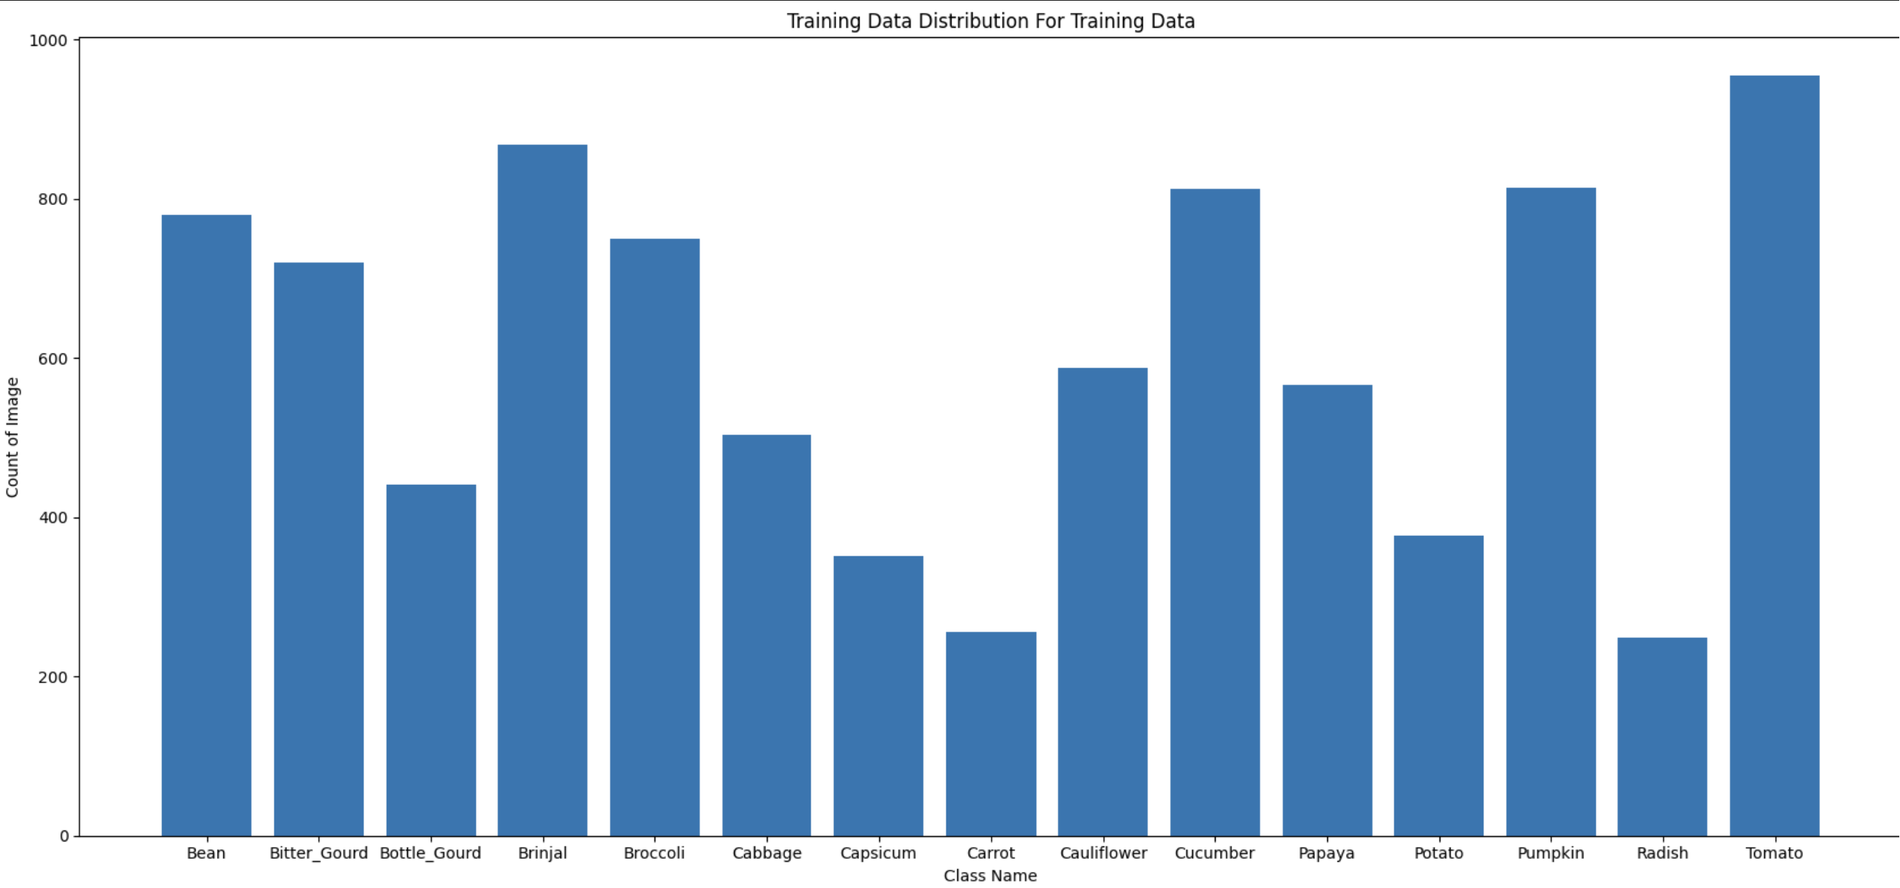
Exploratory Data Analysis

Slide 5
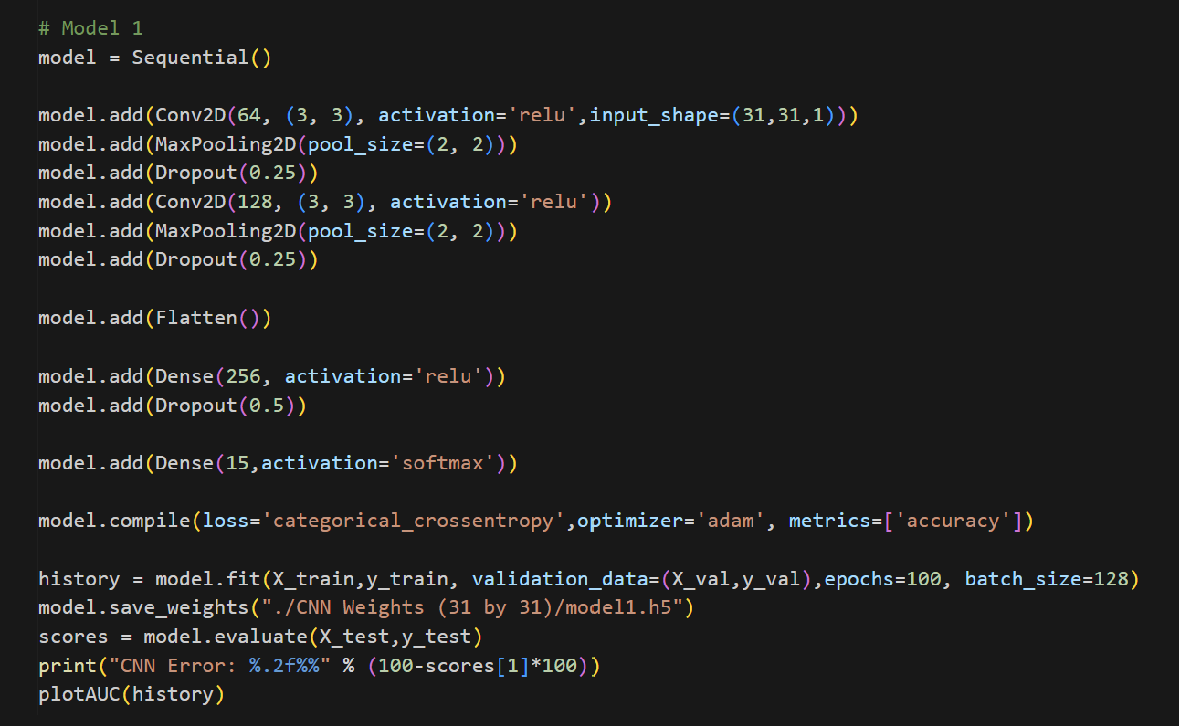
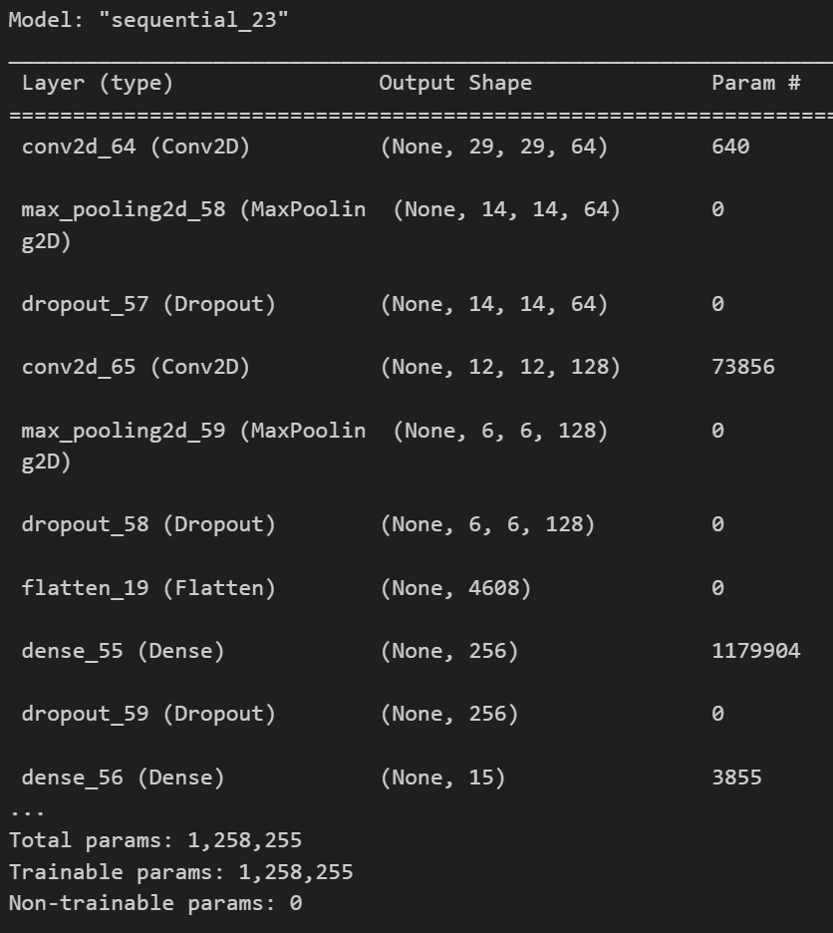
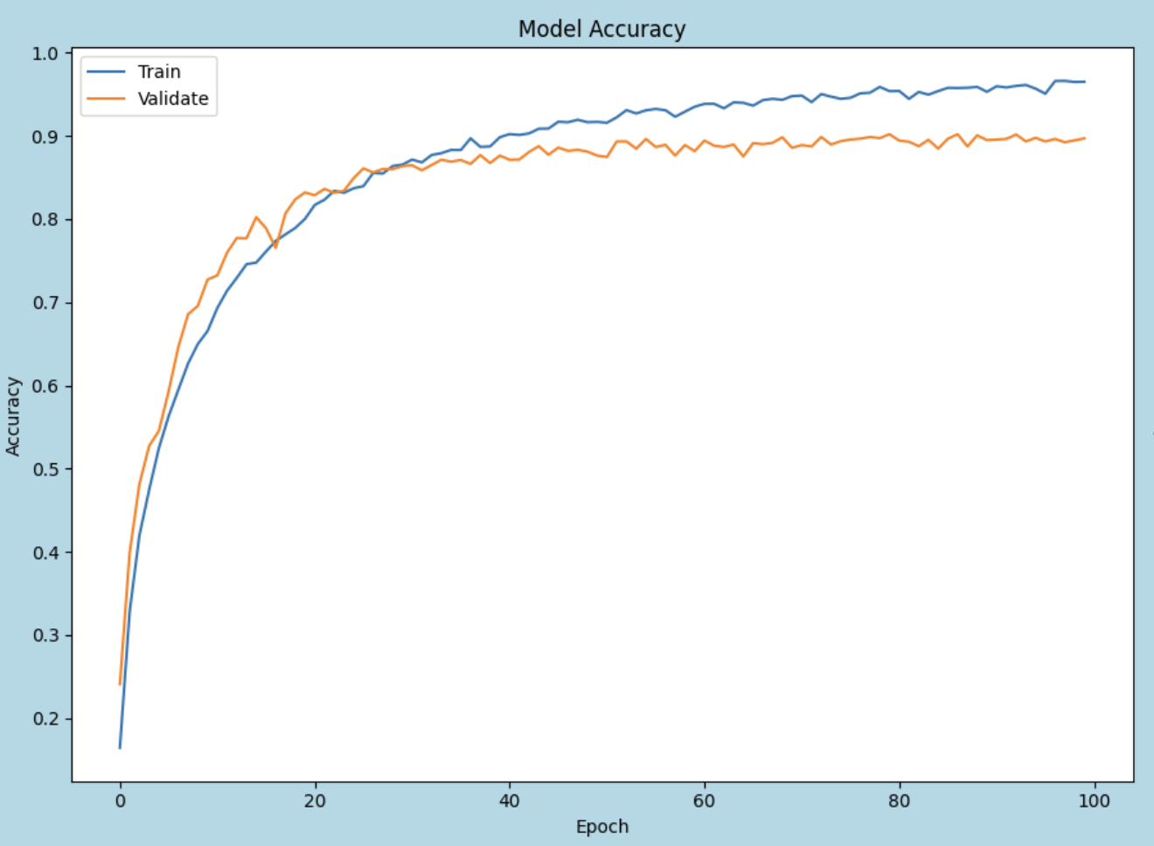
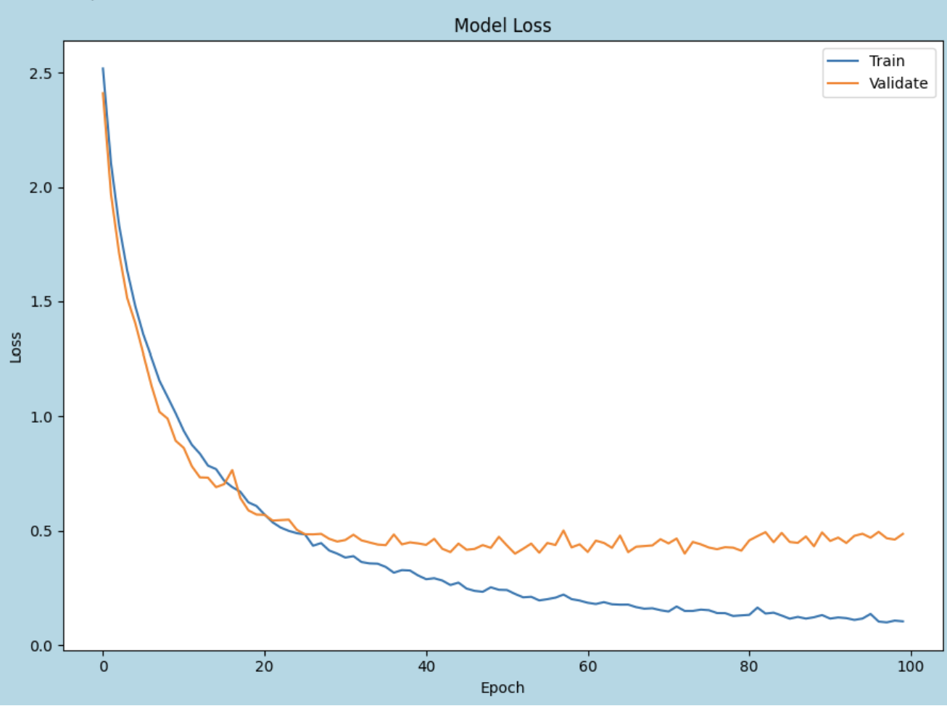
Modelling 31 by 31 (Model 1)
Model 1 is designed to be a simple model. The model is overfitting at first, achieving a high training accuracy of 1.0 whereas a lower validation score at first. Hence, I incorporate Dropouts into Model 1 layers.

Slide 6
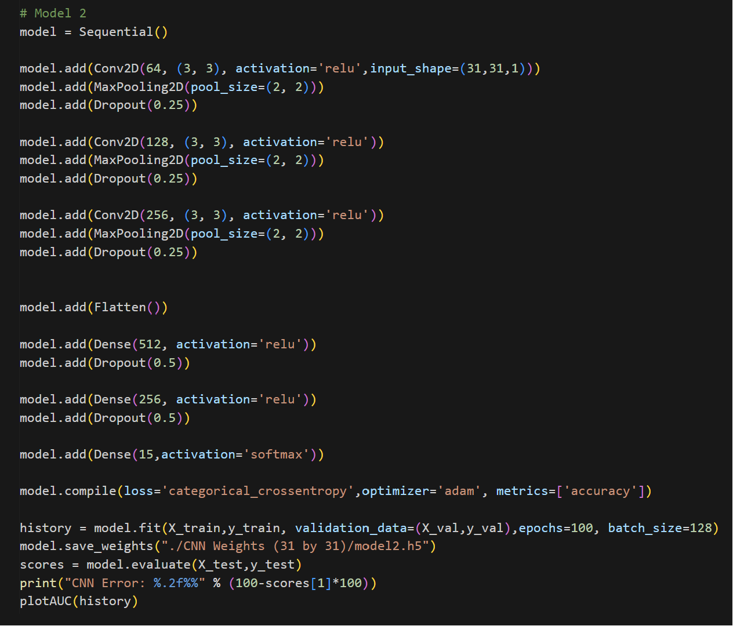
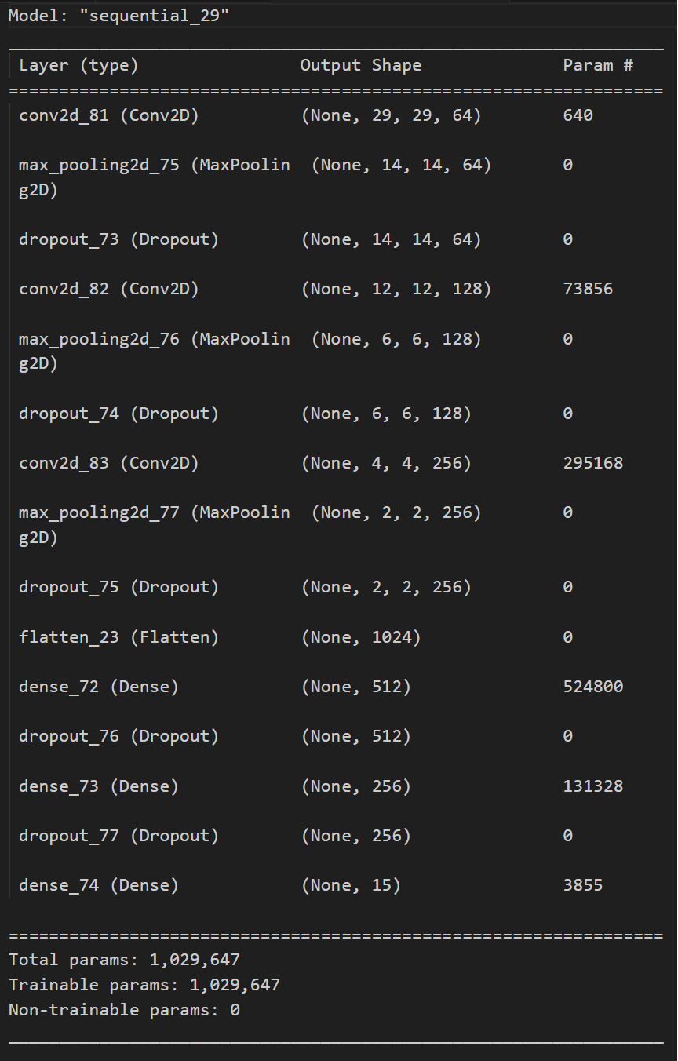
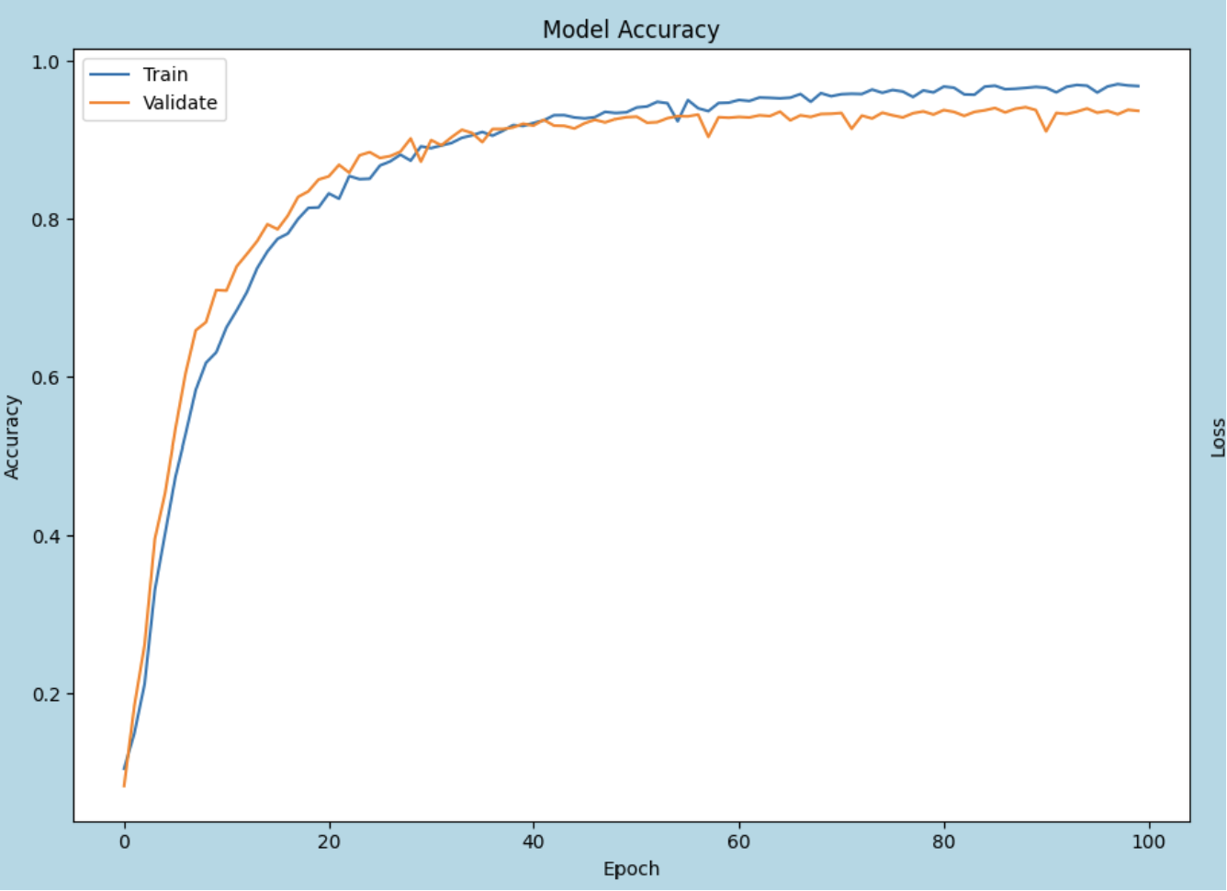
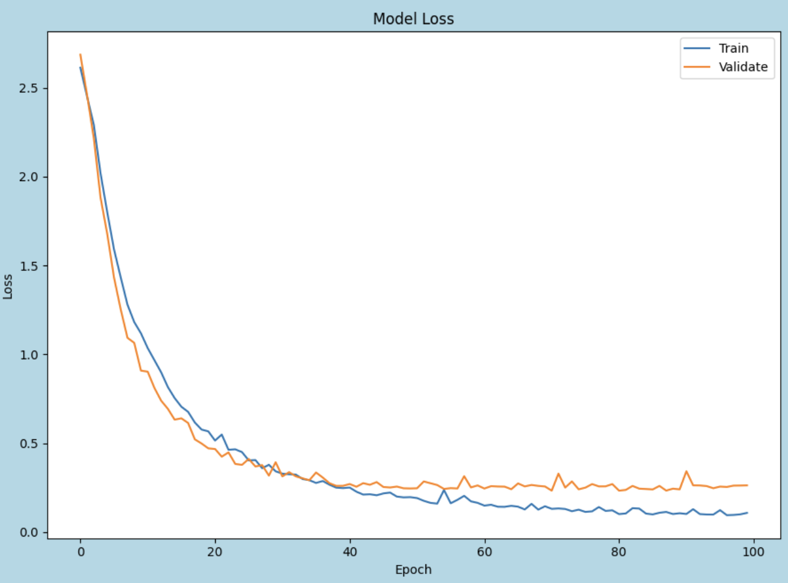
Modelling 31 by 31 (Model 2)
Model 2 will be a deeper model with extra layers compared to Model 1. This complexity aims to capture more patterns when classifying the image. After incorporating dropout to my layers, there is an increase in both the train and validation accuracy suggesting a positive impact. I then experimented with different dropout values to determine the optimal value.

Slide 7
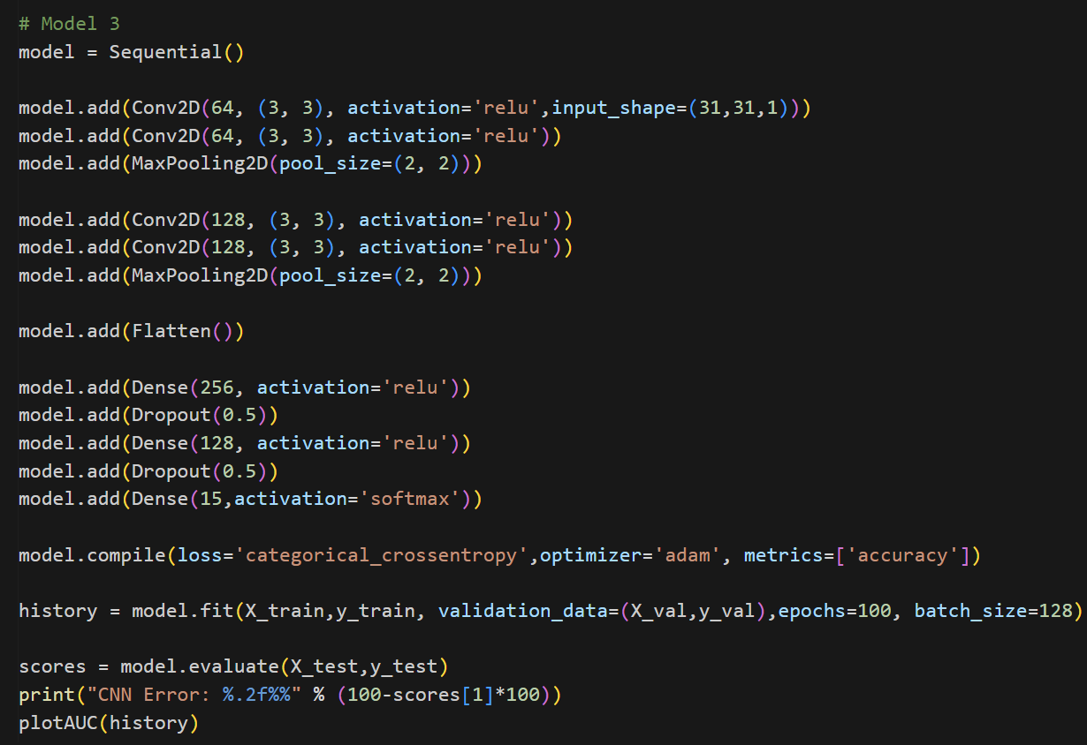
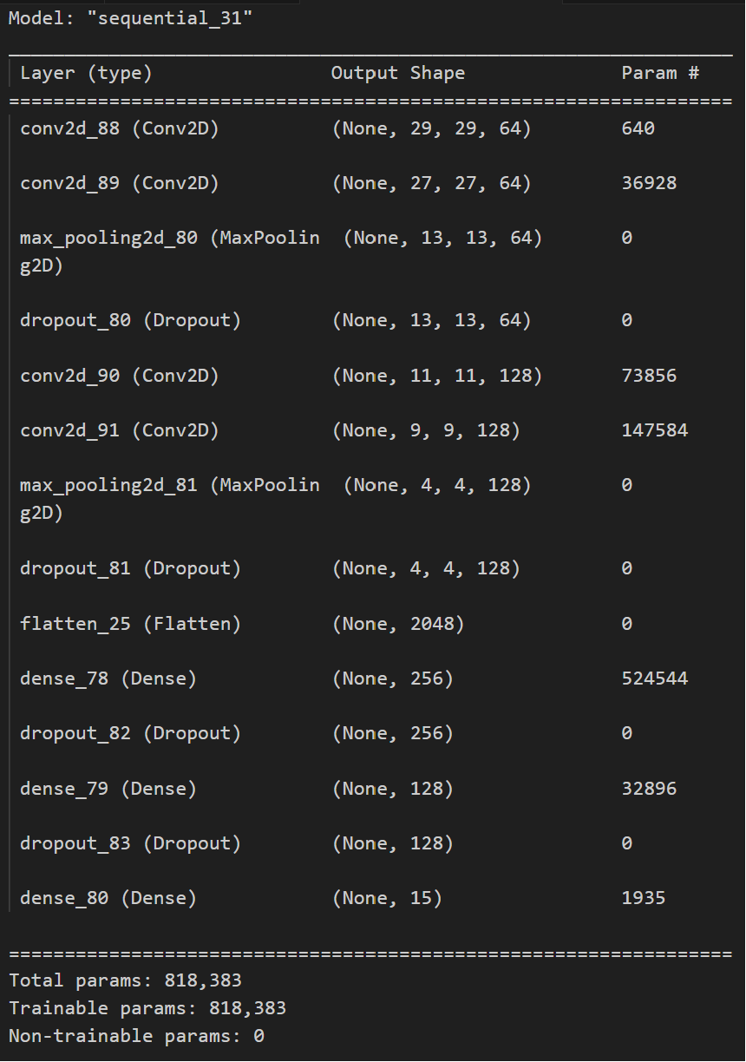
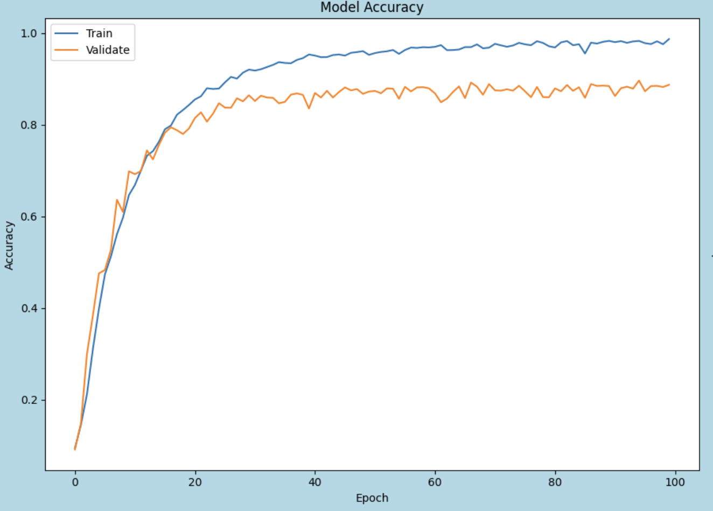
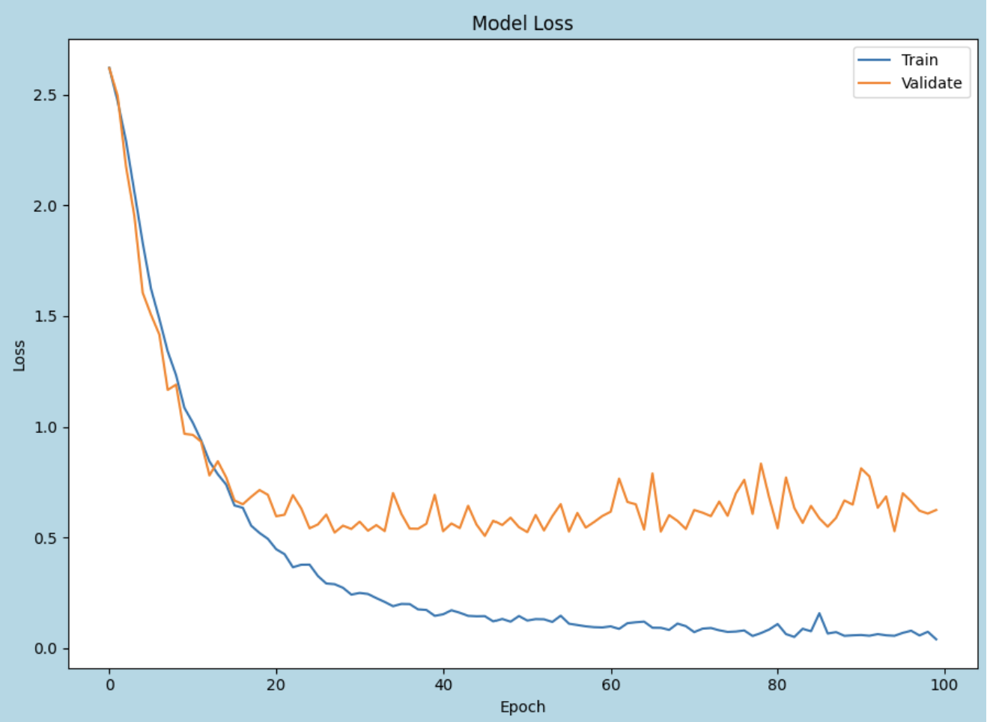
Modelling 31 by 31 (Model 3)
Model 3 will be a deeper model with stacked layers. Dropouts was incorporated to curb overfitting.

Slide 8
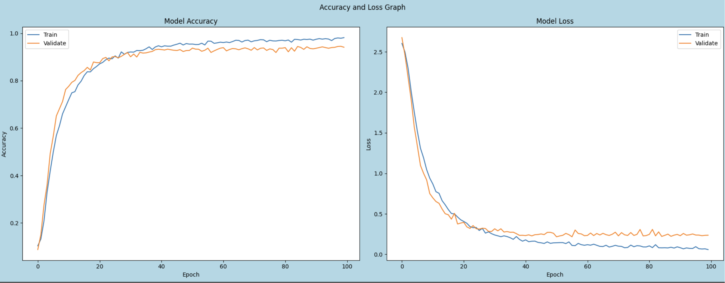
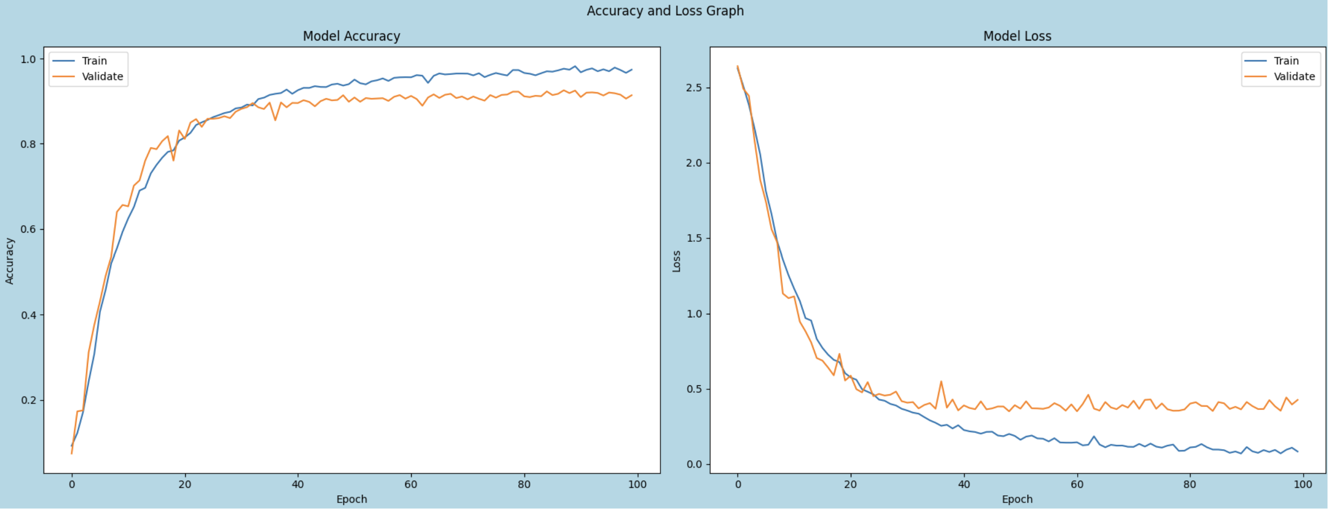
Data Augmentation (31 by 31)
Model 2 (Random Flip)
Model 3 (Random Flip)
- From the scores, I will choose Model 2 and Model 3 to further improve it due to its high test and validation accuracy scores. We will add horizontal Random Flip and Gaussian Noise and assess it separately. Random Flip improved model 2 and 3 accuracy by only 0.4% and 1% respectively, however the training time has also increased x2 times.
- Upon weighing the trade off between time and accuracy, we will not implement it. Data augmentation is not as effective. Therefore, we will not implement it.

Slide 9
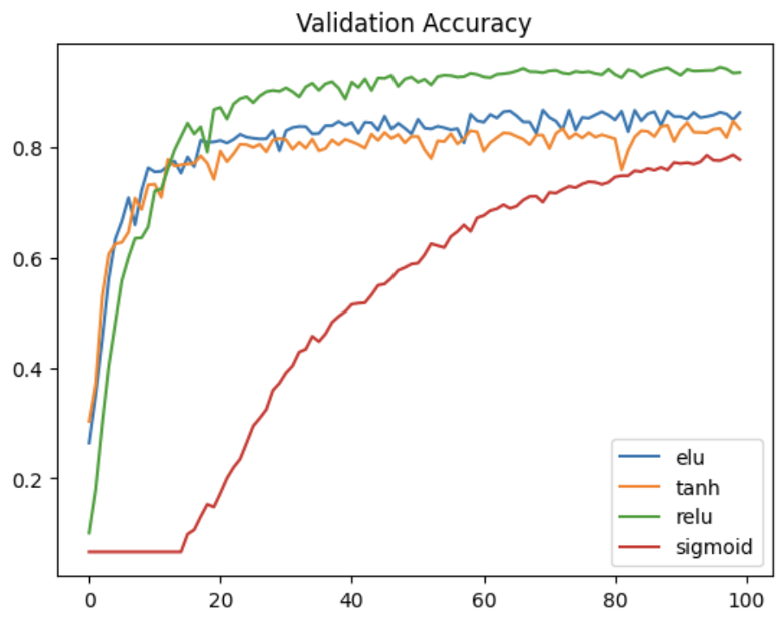
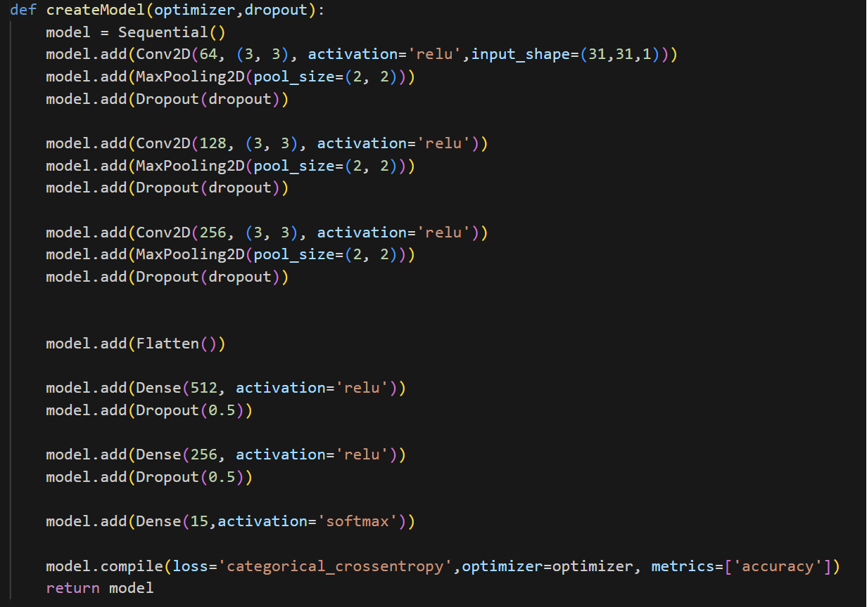
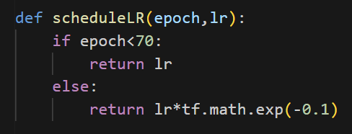
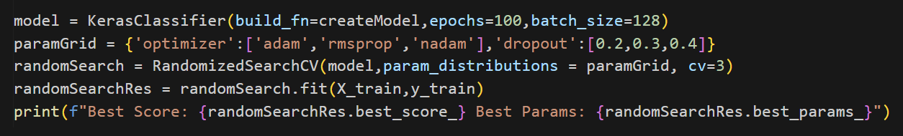
Model Improvement
We will further improve Model 2 as it has the higher test and validation accuracy than model 3
Compare Activation Function
Tuning Hyper-parameter
Schedule Learning Rate

Slide 10
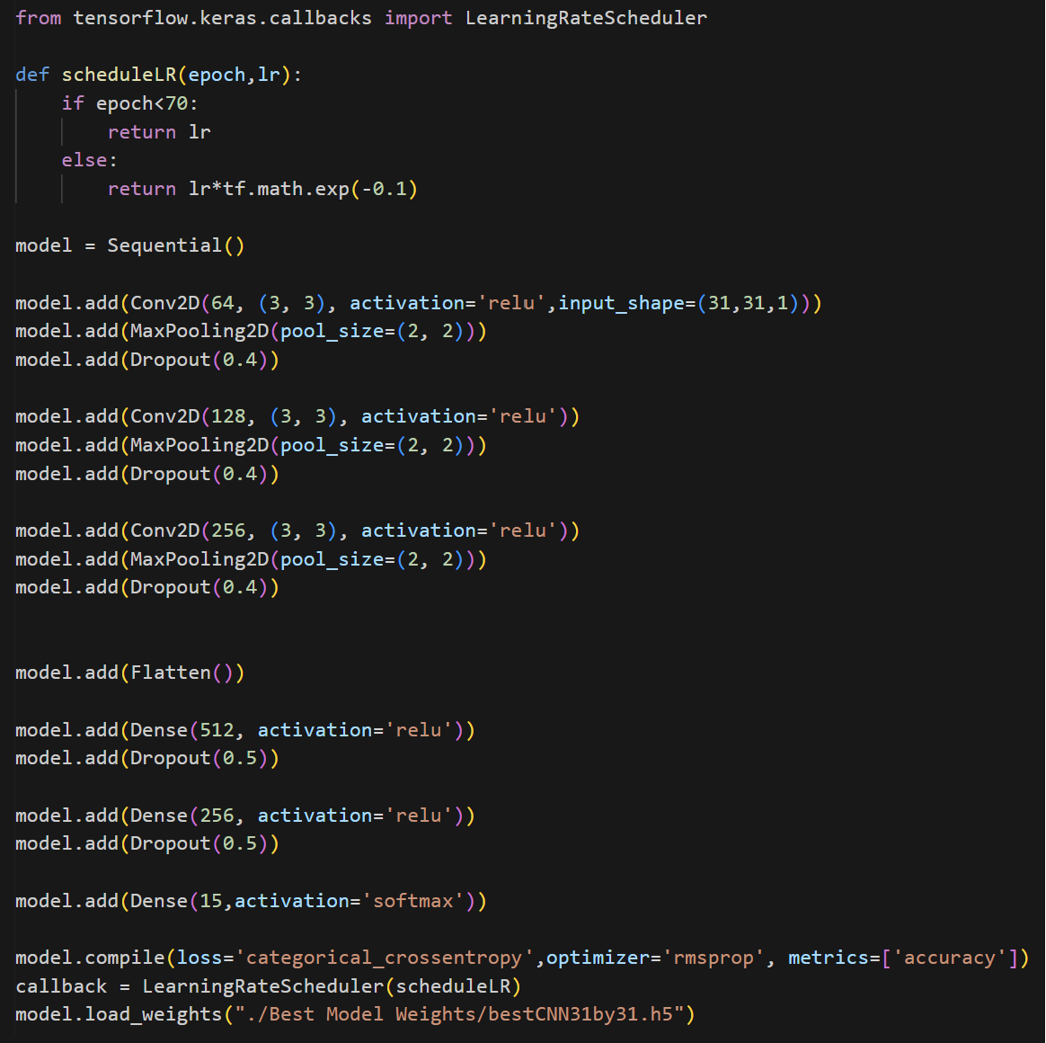
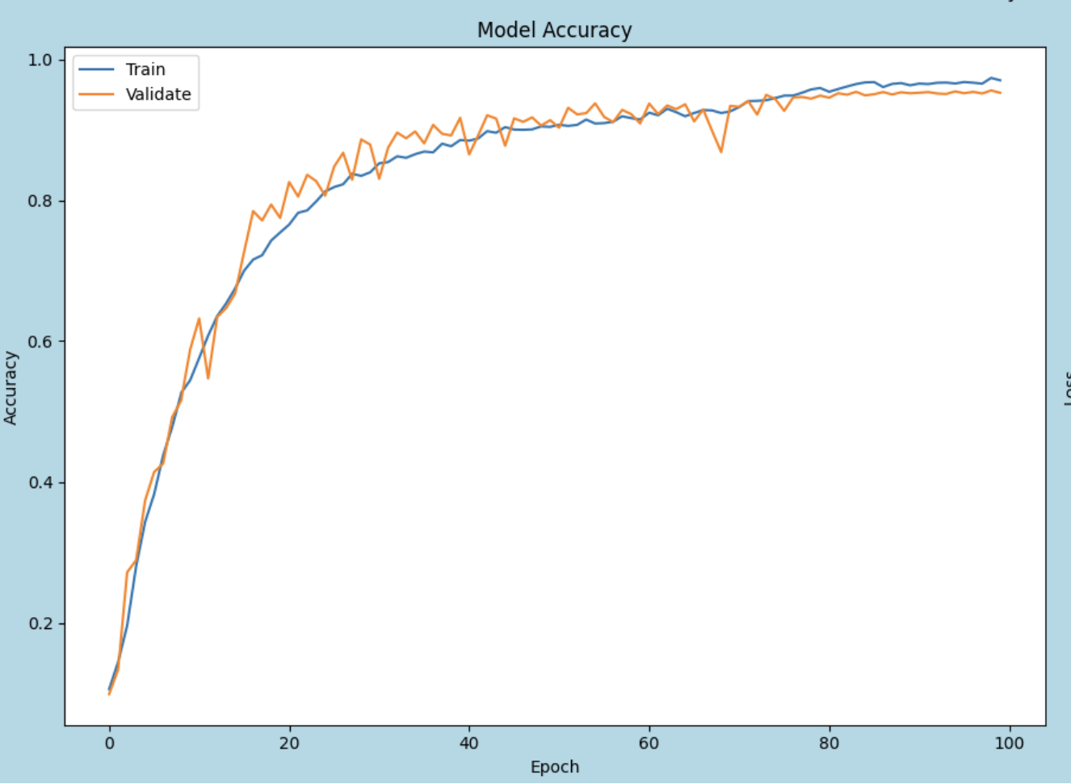
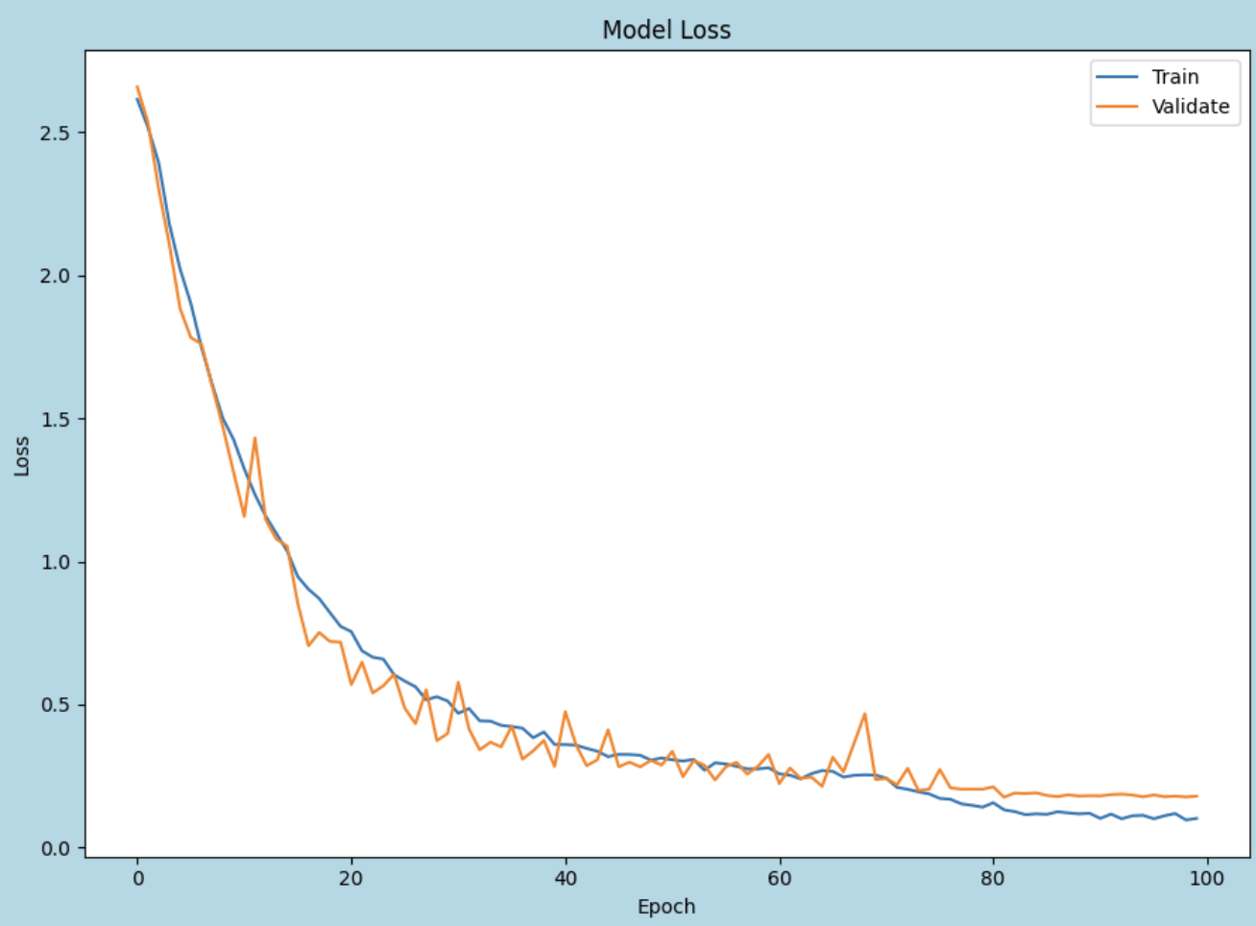
Final 31 by 31 Model
Before model improvement
Test Accuracy: 93.67%
Validation Accuracy: 93.70%
After model improvement,
Final 31 by 31 model: Test Accuracy: 95.57%
Validation Accuracy: 95.30%

Slide 11
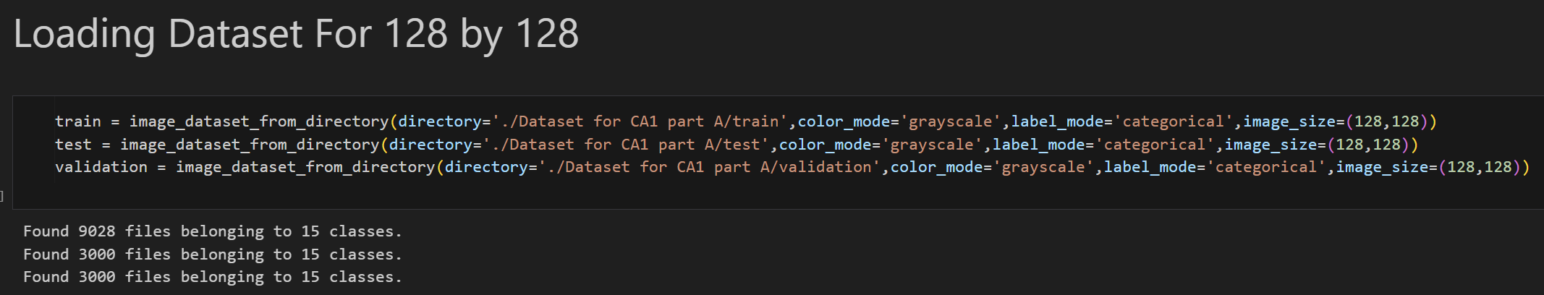
Data Preparation (128 by 128)
Loading of Dataset
Data Preparation
Data Standardization

Slide 12
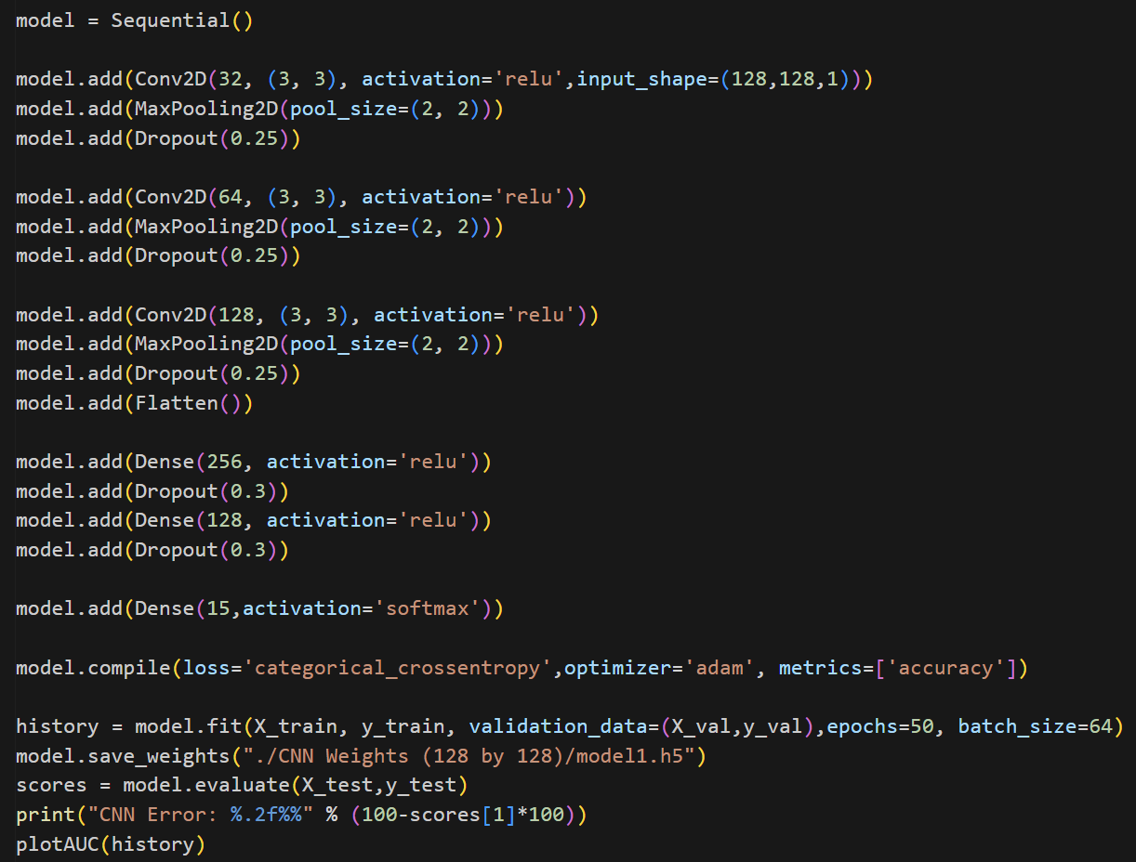
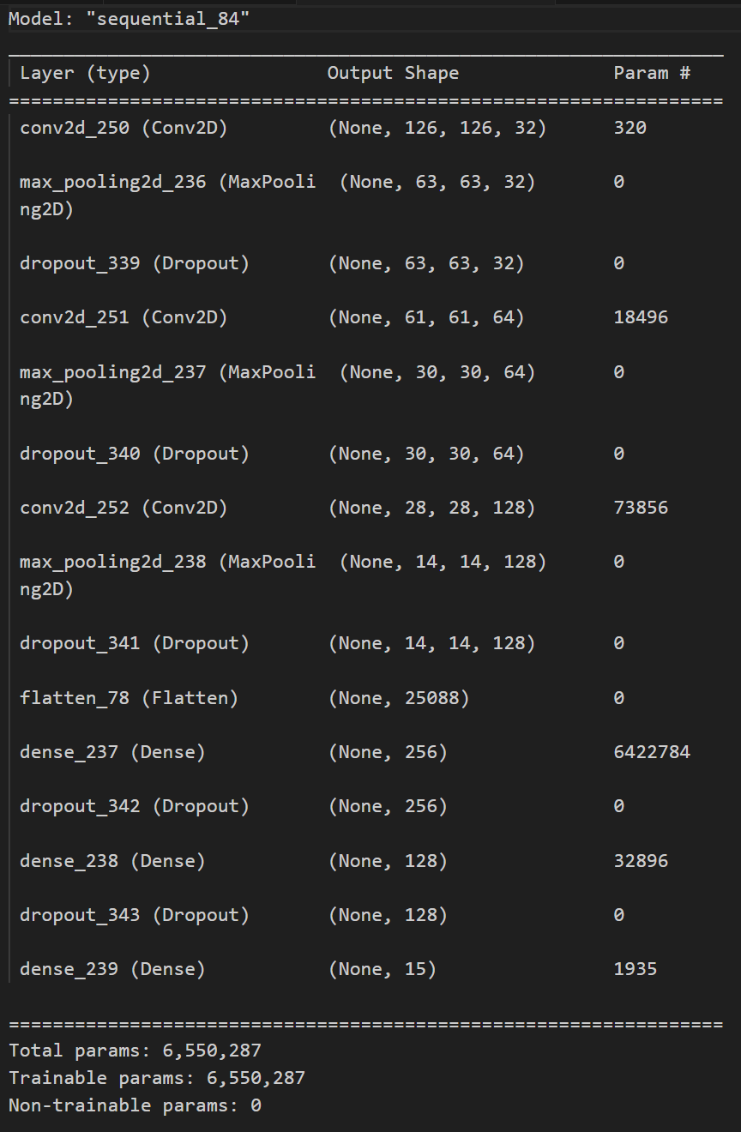
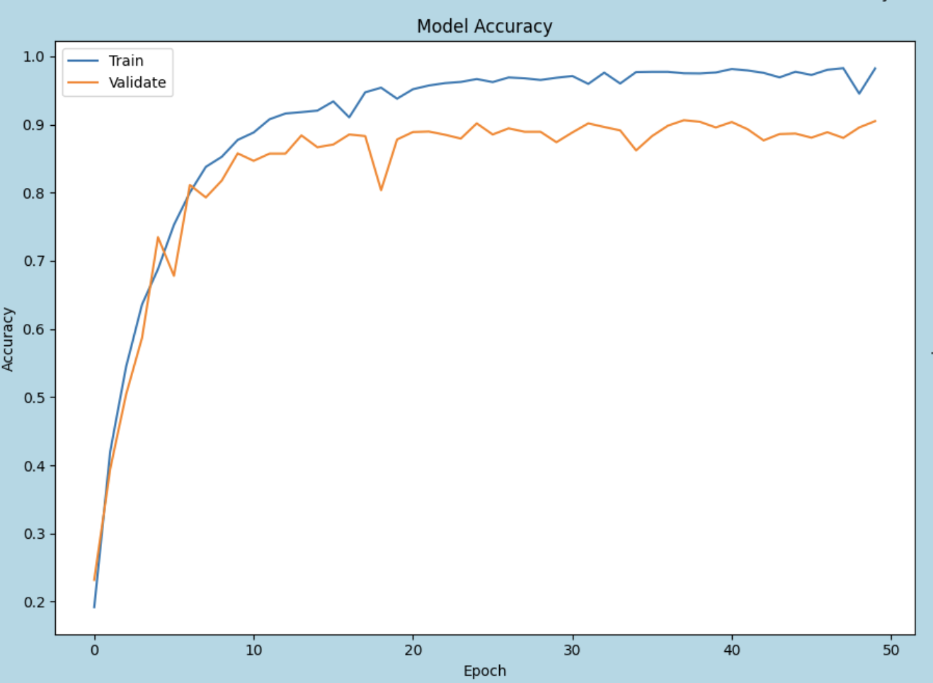
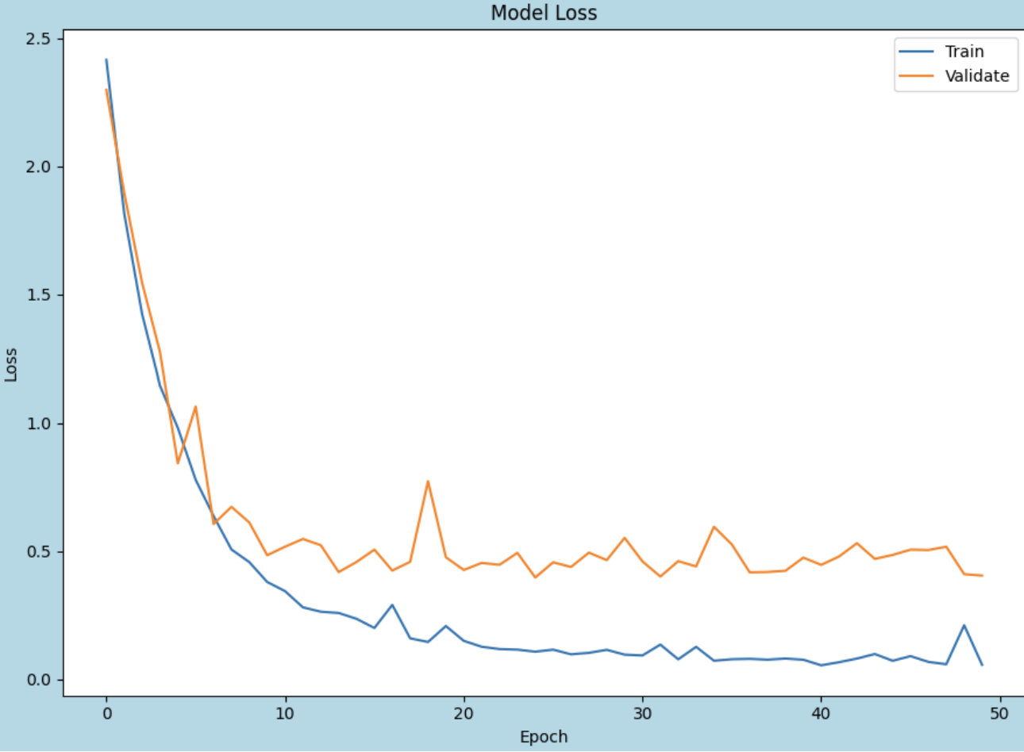
Modelling 128 by 128 (Model 1)
An extra layer was introduced because the image dimension has increased

Slide 13
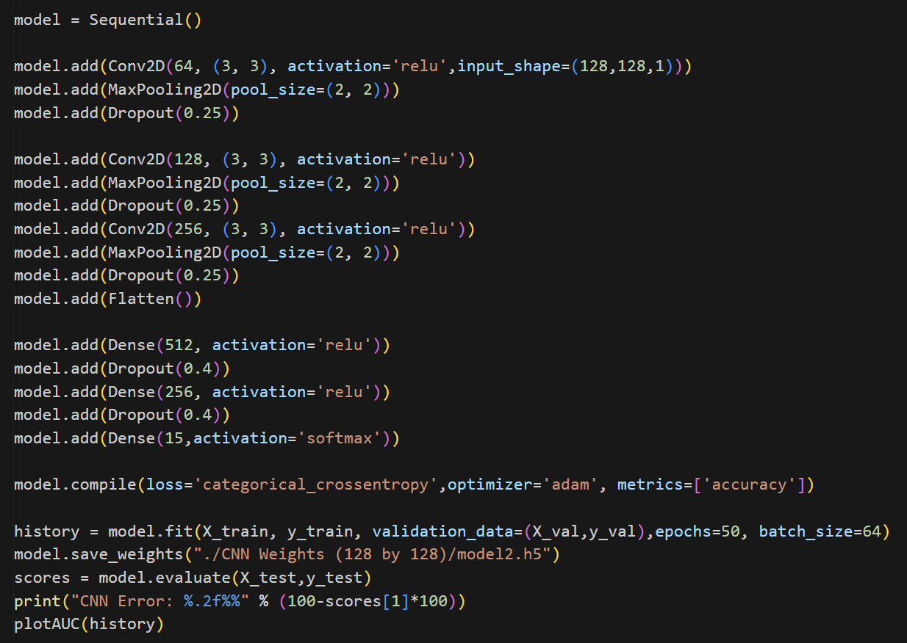
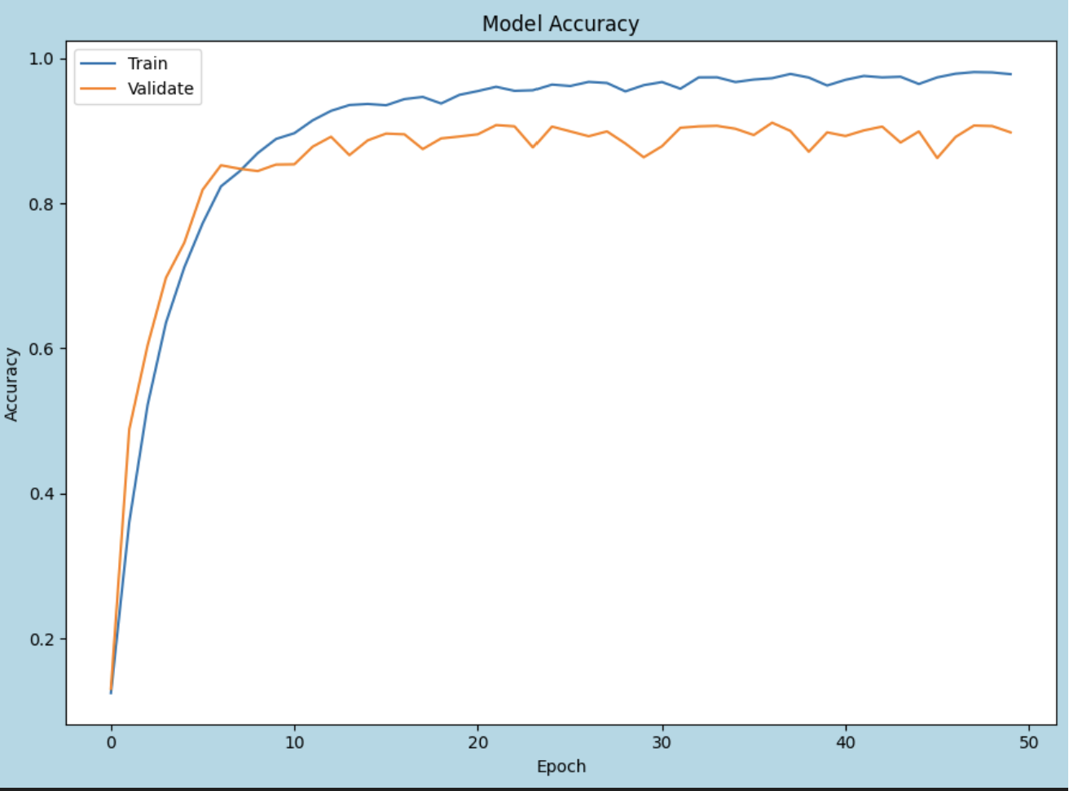
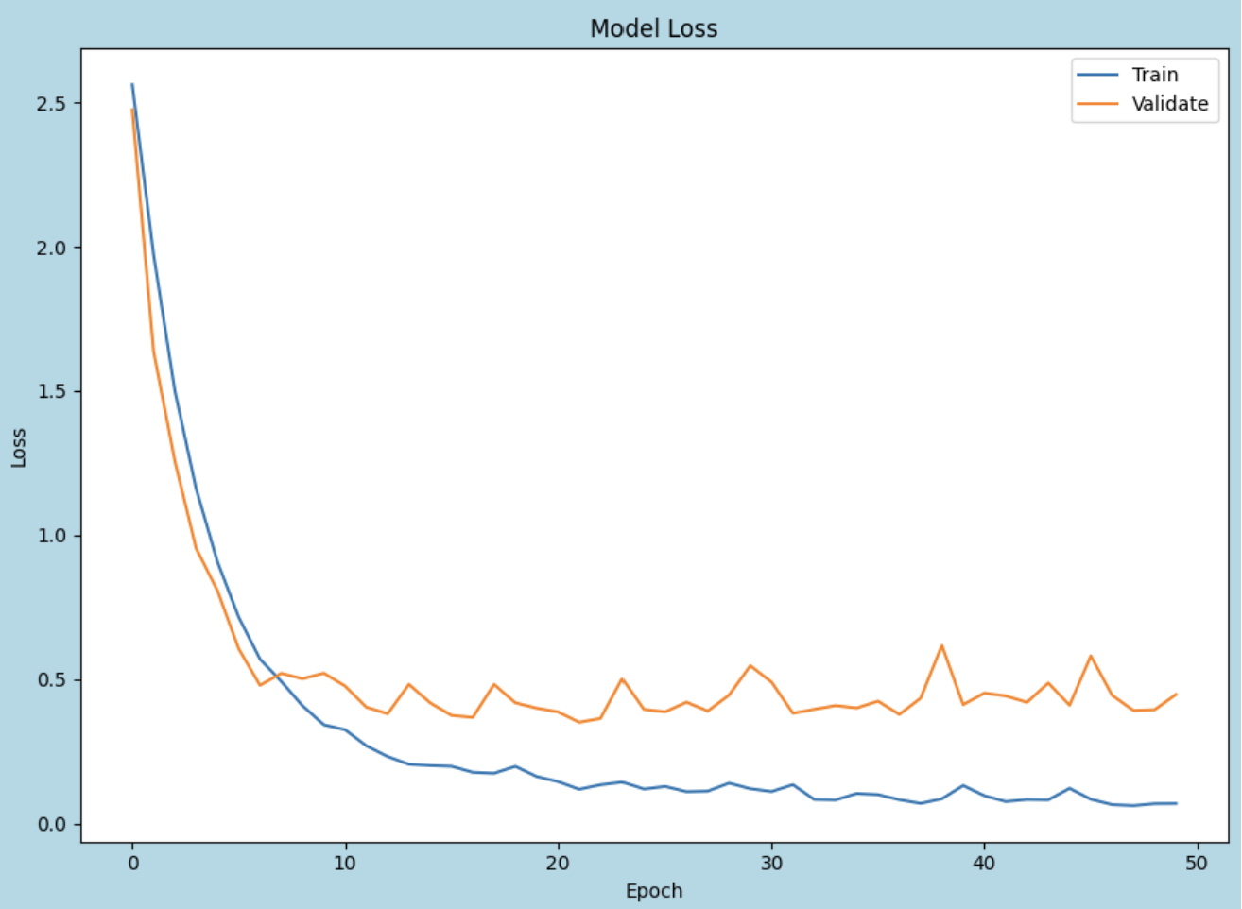
Modelling 128 by 128 (Model 2)
Model 2 have the same layers as the 31 by 31 model with a smaller dropout.

Slide 14
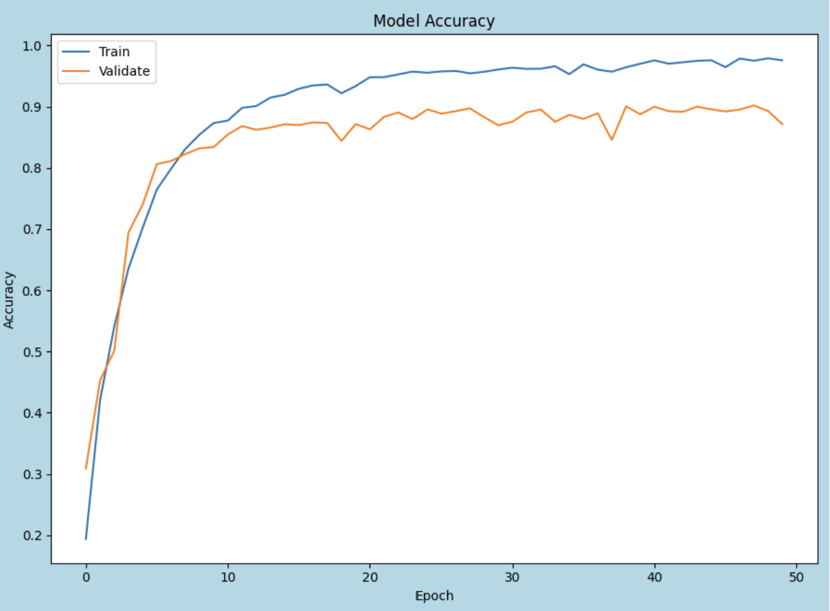
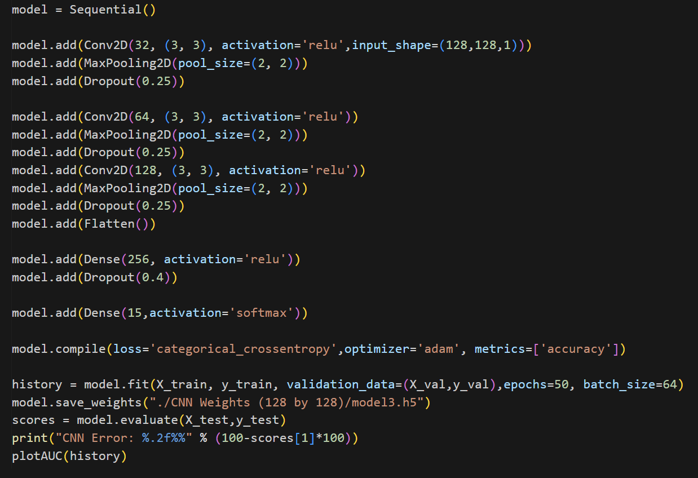
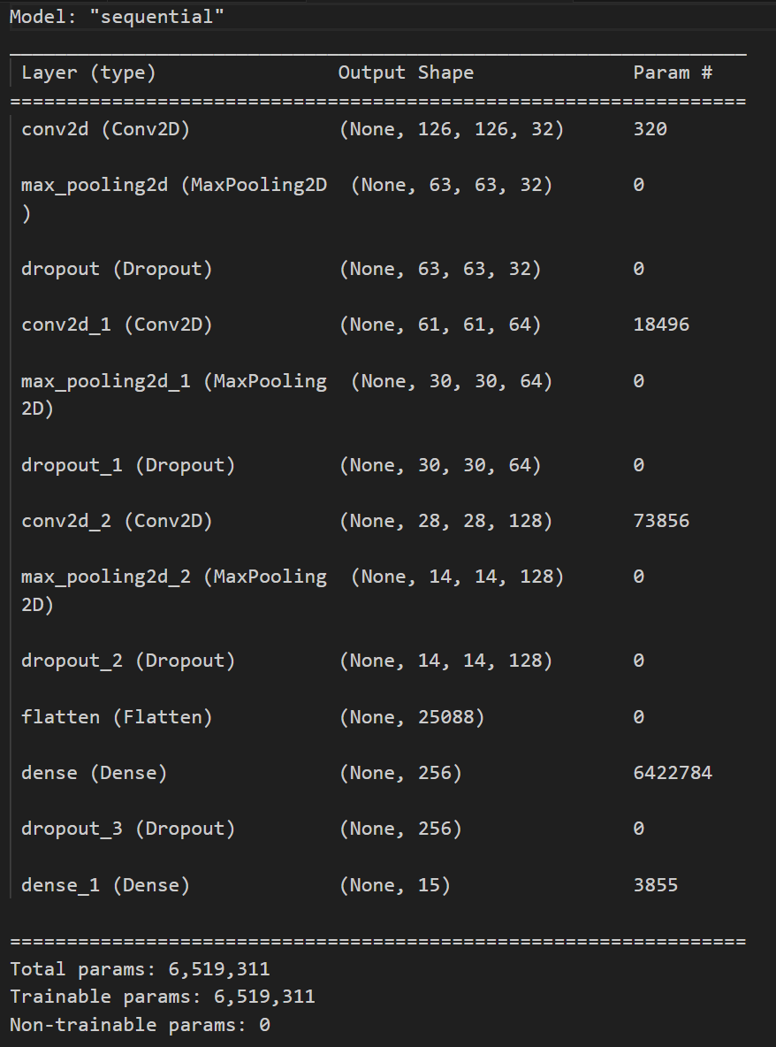
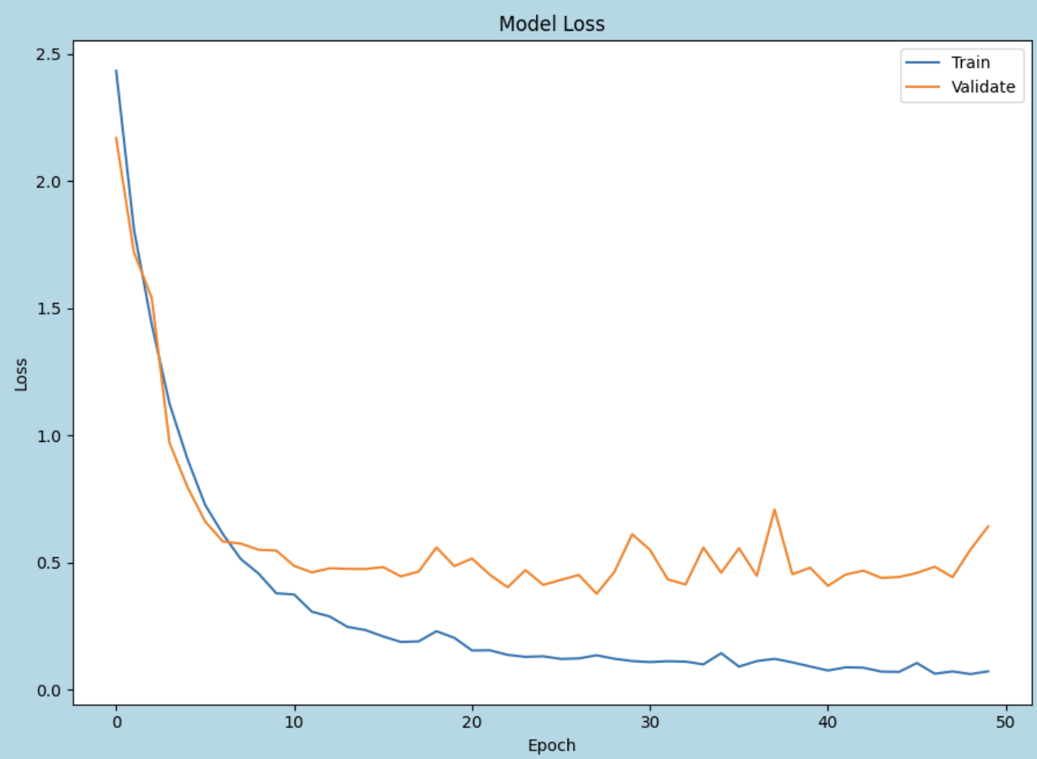
Modelling 128 by 128 (Model 3)
Model 3 is created with one less Dense layer.

Slide 15
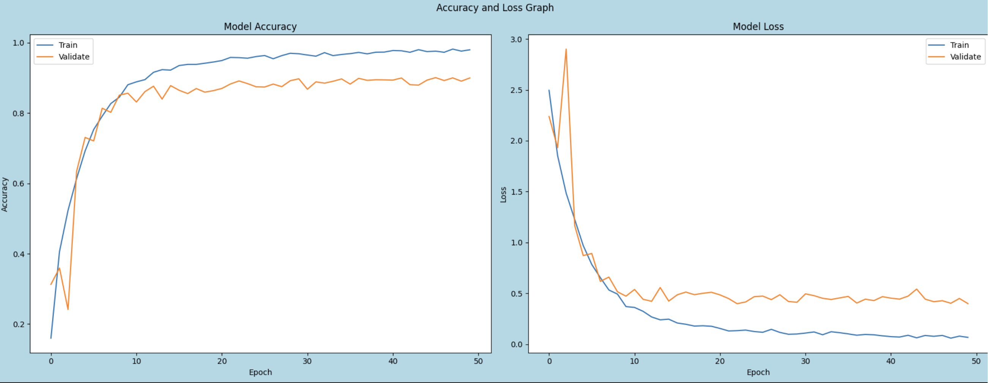
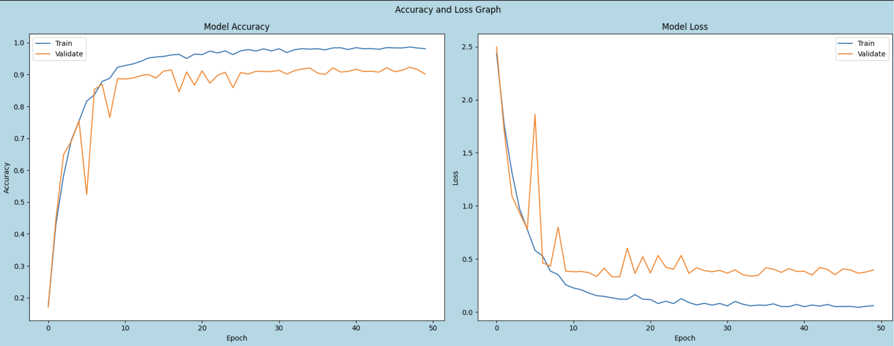
Data Augmentation (128 by 128)
Model 1 (Random Flip)
Model 2 (Random Flip)
- From the scores, I will choose Model 1 and Model 2 to further improve it due to its high test and validation accuracy scores. We will add horizontal Random Flip and assess it.
- Random Flip improved model 2 accuracy by only 1% and about a similar validation score however the training time has also increased by 2 minutes. Upon weighing the trade off between time and accuracy, we will not implement it.

Slide 16
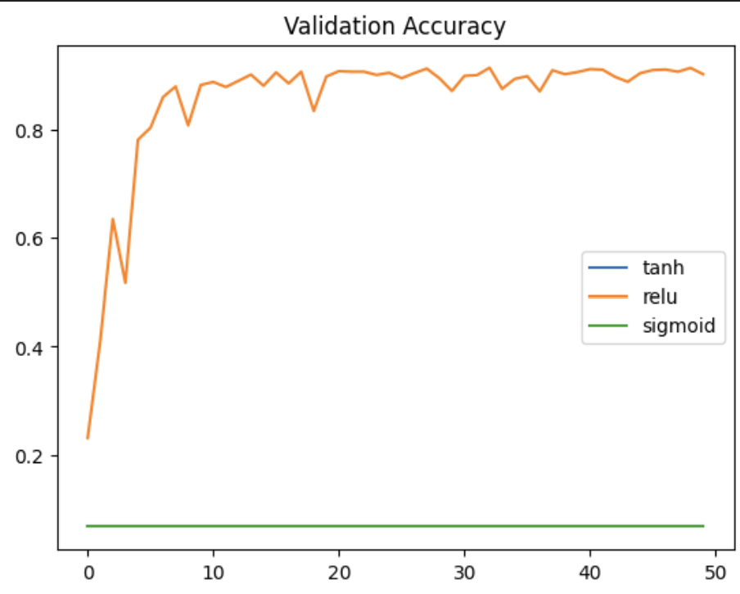
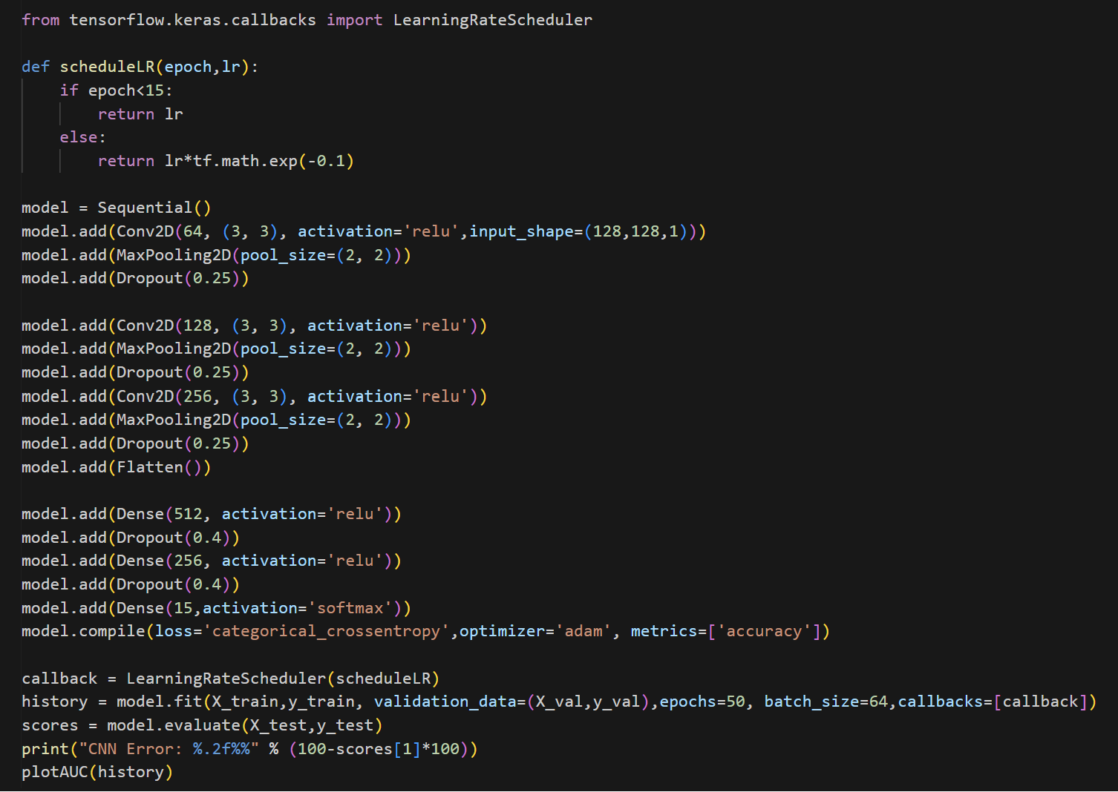
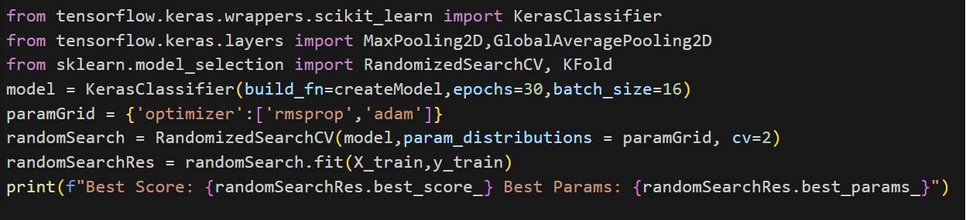
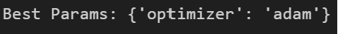
Model Improvement
We will further improve Model 2 as it has the higher test and validation accuracy than model 1
Compare Activation Function
Tuning Hyper-parameter
Schedule Learning Rate

Slide 17
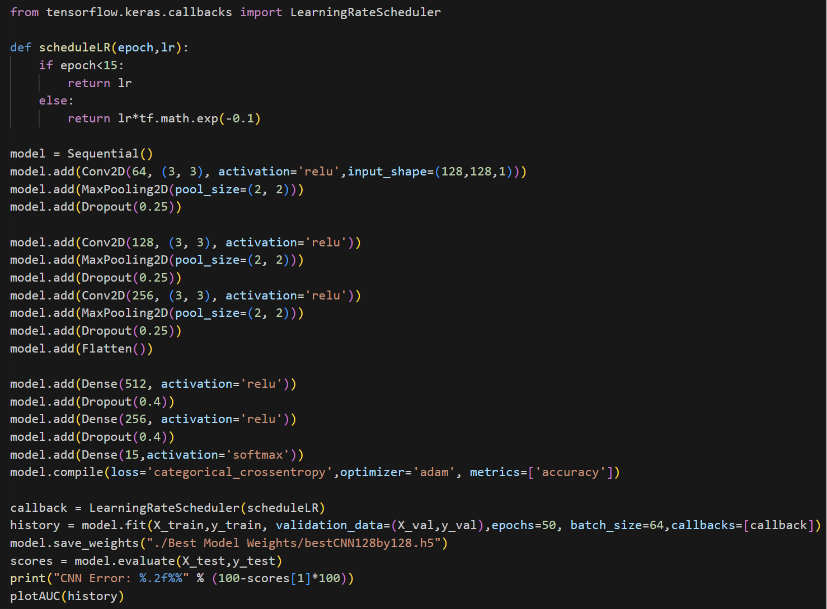
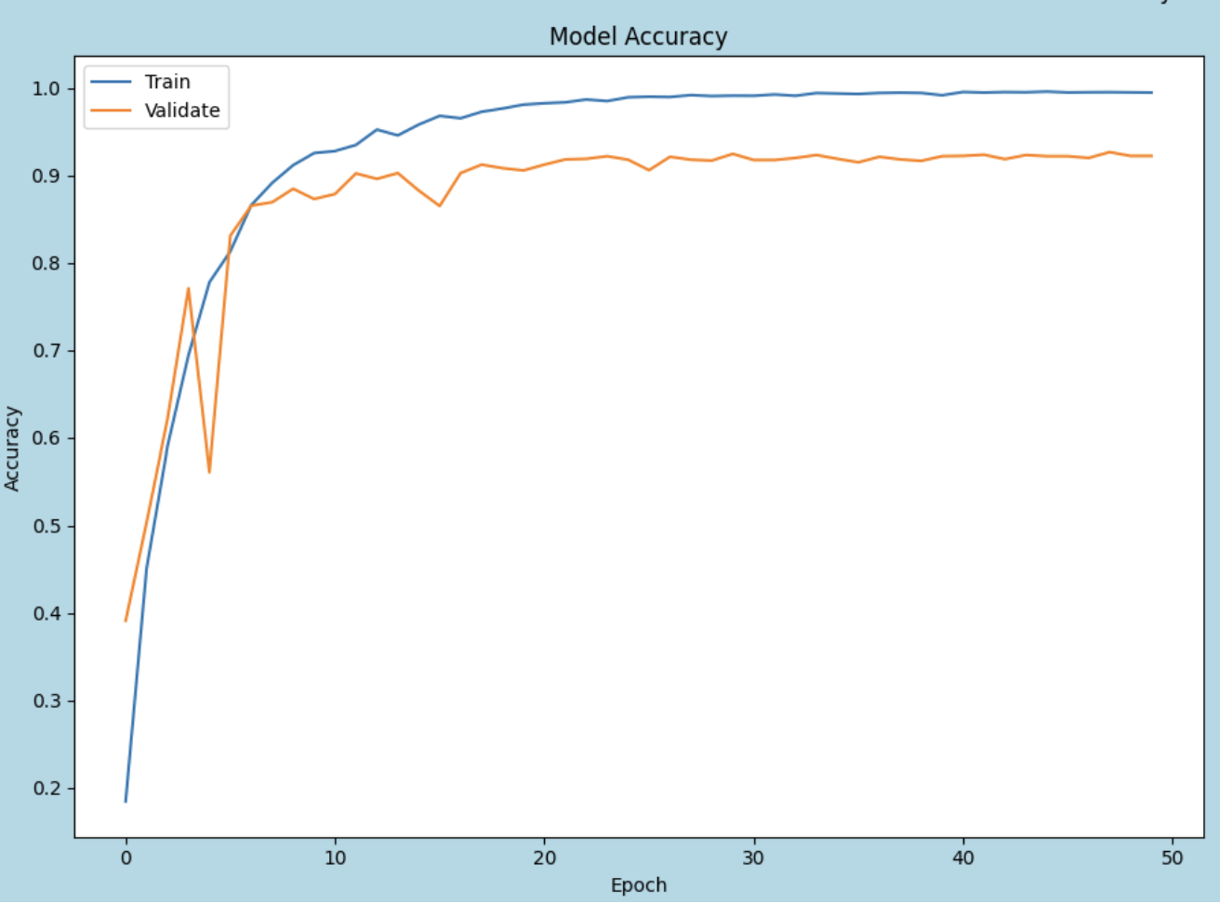

Final 128 by 128 Model
Before model improvement
Test Accuracy: 90.47%
Validation Accuracy: 89.77%
After model improvement,
Final 128 by 128 model: Test Accuracy: 92.8%
Validation Accuracy: 92.80%

Slide 18
Conclusion
Final 31 by 31 model: Test Accuracy: 95.57%
Validation Accuracy: 95.30%
Final 128 by 128 model: Test Accuracy: 92.8%
Validation Accuracy: 92.80%
The 31 by 31 model is achieving a better test and validation accuracy than 128 by 128 model. This can be due to smaller images containing more sufficient information whereas the larger image might introduce more complexity which makes it harder for the model to capture the patterns.
All in all, this assignment has allowed me to learn more in depth about image classification using CNN and how image classification is important in real world applications.

